Slide 1
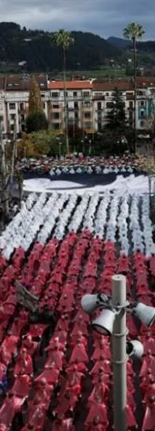
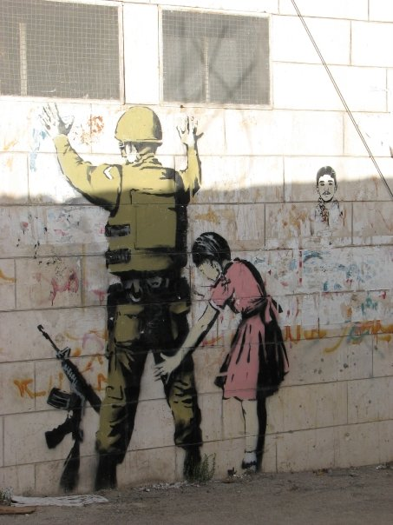
Interrogating notions of peace
Dr Mahdis Azarmandi
University of Canterbury

Slide 2
International Relations - Peace Studies: what is peace?
In both academic scholarship and international politics, peace has often been equated with mere order and stability rather than encompassing reparative justice. The ongoing events in Gaza challenge simplistic binaries of war and peace, violence and nonviolence, revealing the disconnect between decolonization and peace pursuits.

Slide 3
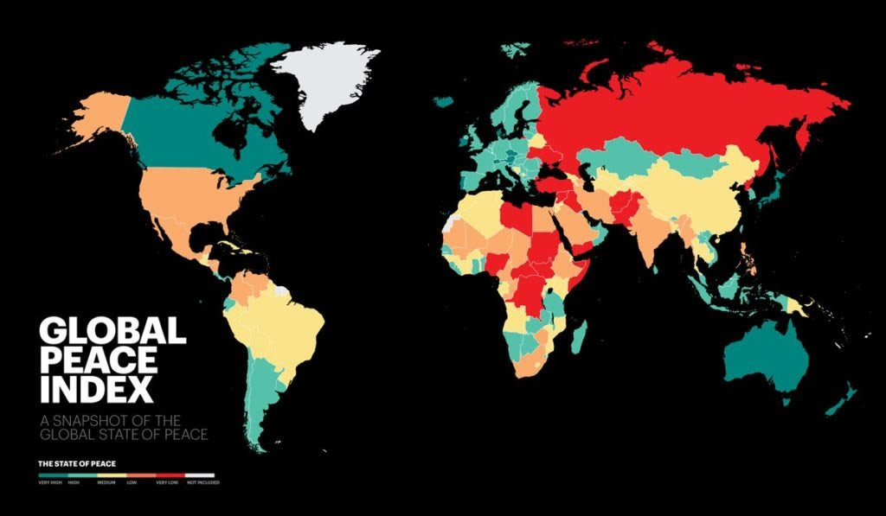
geographies of peace and violence

Slide 4
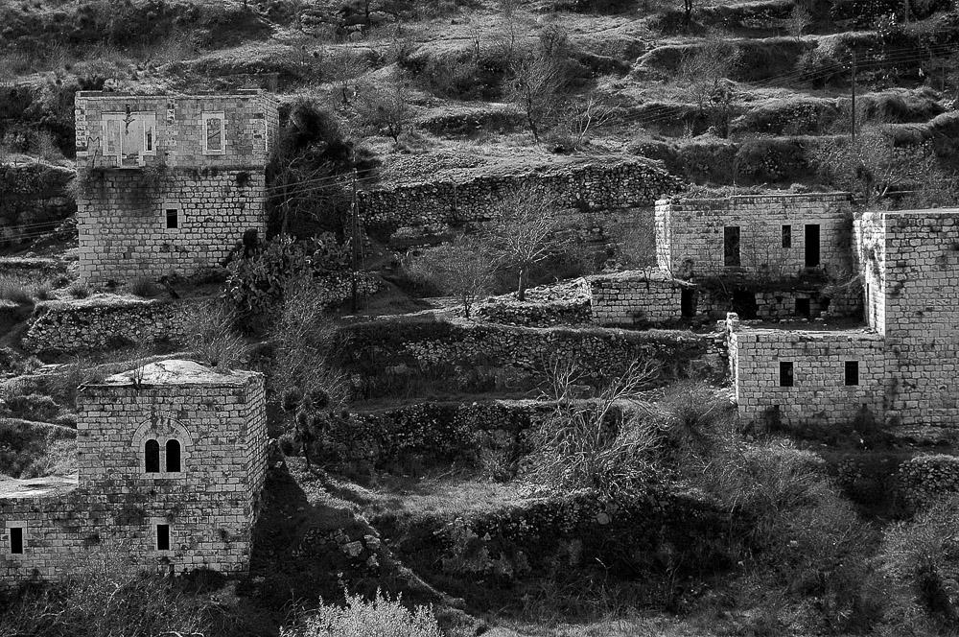
Geographies of peace and violence
Lifta was a Palestinian village on the outskirts of Jerusalem. The population fled during the Nakba in 1948. The village is fairly intact; in 2012 plans to rebuild the village as an upscale neighborhood were rejected by the Jerusalem District Court. Photo by Aisha Mershani

Slide 5
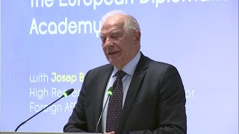

Slide 6
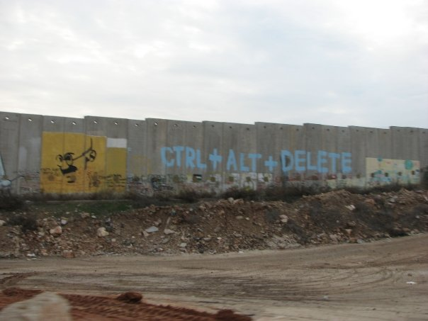
Europe is imagined as a bastion of democracy and peace, juxtaposed with the portrayal of the rest of the world as a "jungle of conflict" and violence, reinforcing geographical and racial divisions in ideas of peace and violence.
The dichotomy between "garden" and "jungle," like darkness and light, is not merely territorial but also racial, delineating those perceived as white from racial others.
This logic of garden and jungle legitimizes a racialized world order, maintaining a white enclosure as essential for preserving the demographics, politics, and economics of whiteness (Rexhepi 2022).

Slide 7
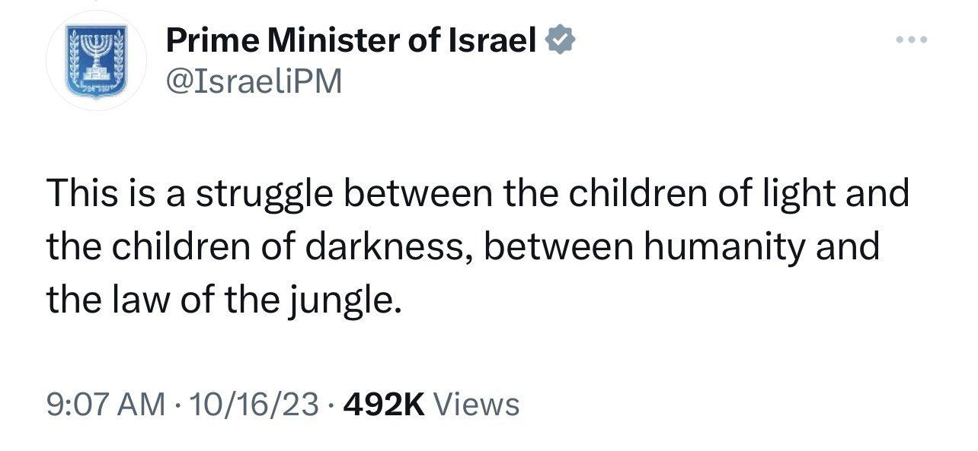

Slide 8
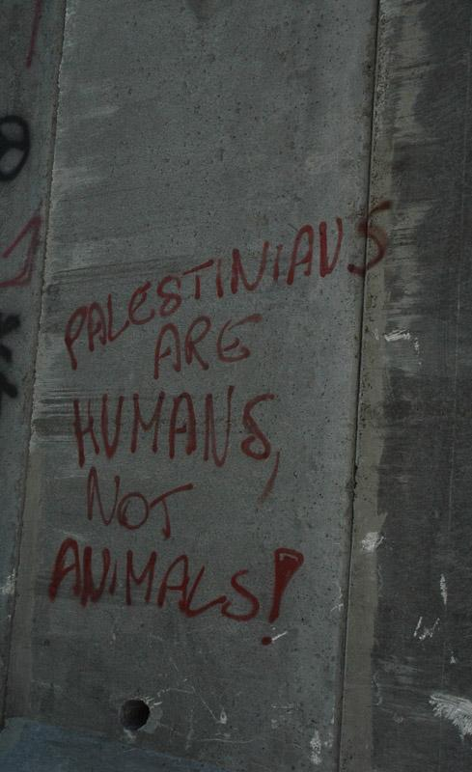
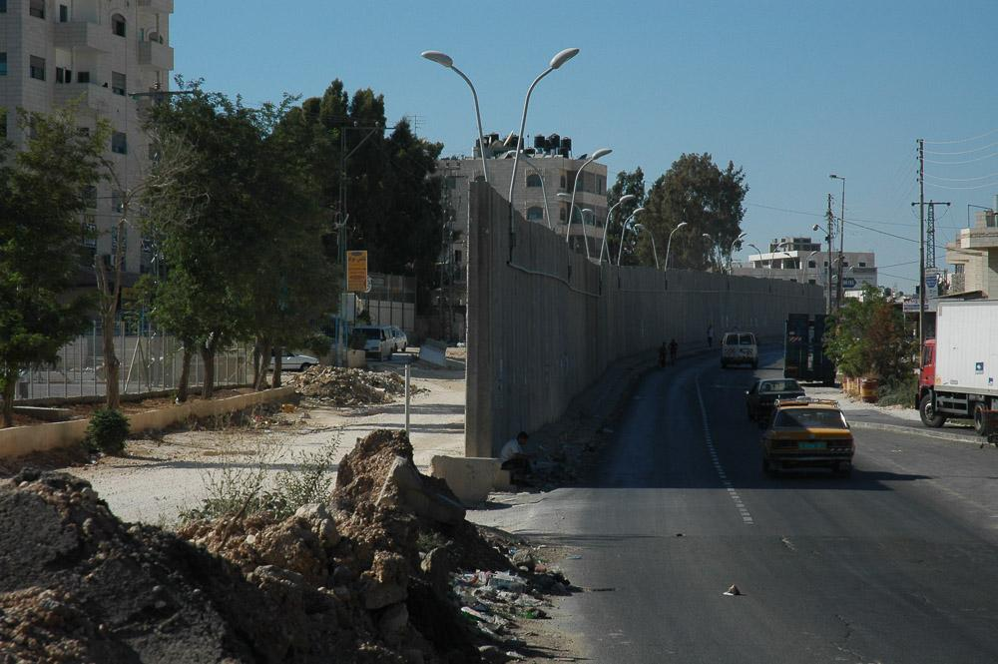
Both the prime minister's tweet and Borrell's speech reflect how civilization and violence are often racially imagined. Moreover, while violence that takes place in what is constructed as the West is constructed and presented as acts of abhorrent terrorism but the violence perpetrated against subjects in the South/ non-West is often framed as justified, proportionate and always-already a reaction to a greater threat of violence from ‘children of darkness’.
A Ram, a Jerusalem suburb, is separated from Jerusalem by a 26 ft concrete wall. It snakes in and out separating houses, and families. Photo by Aisha Mershani

Slide 9
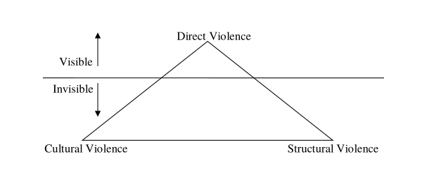
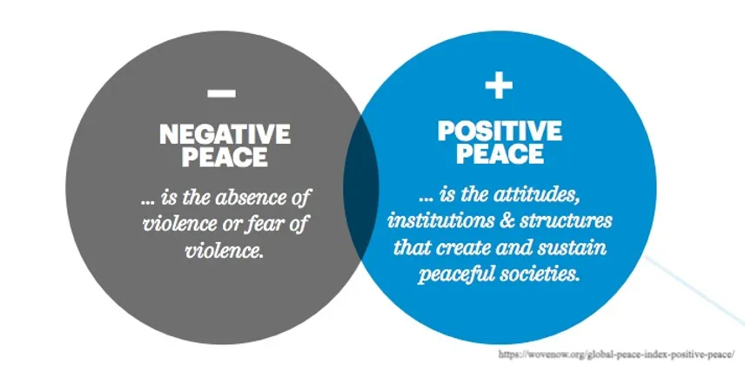
defining peace, war & violence

Slide 11
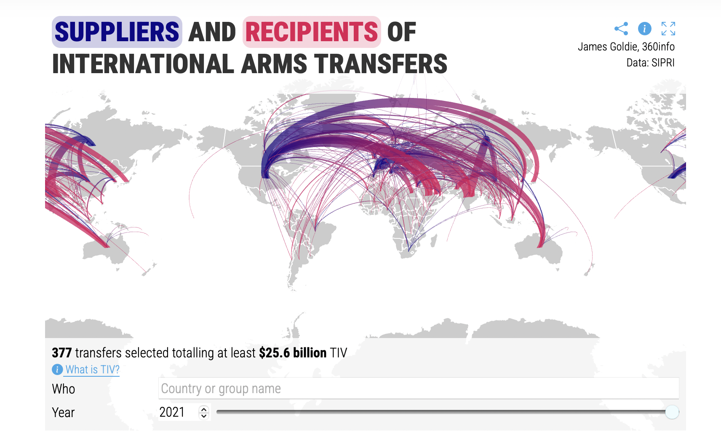

Slide 12
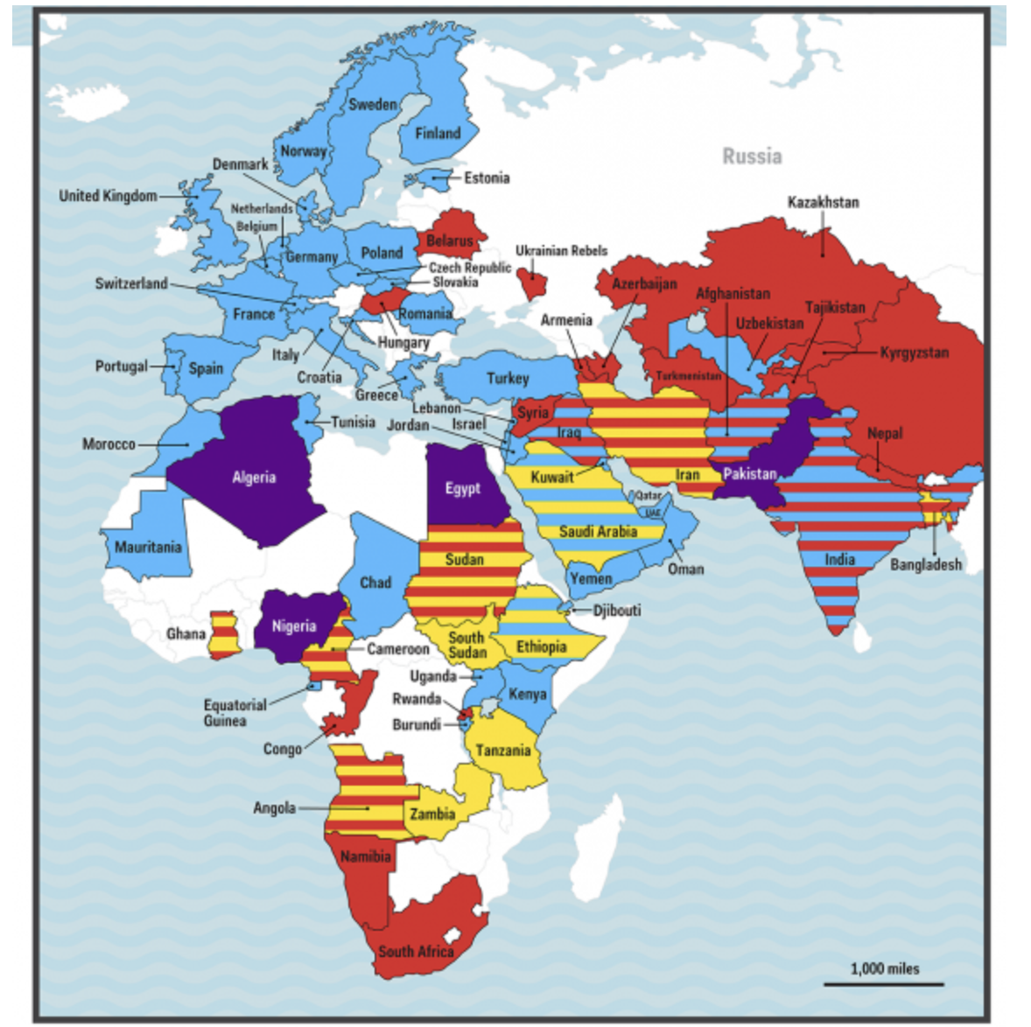
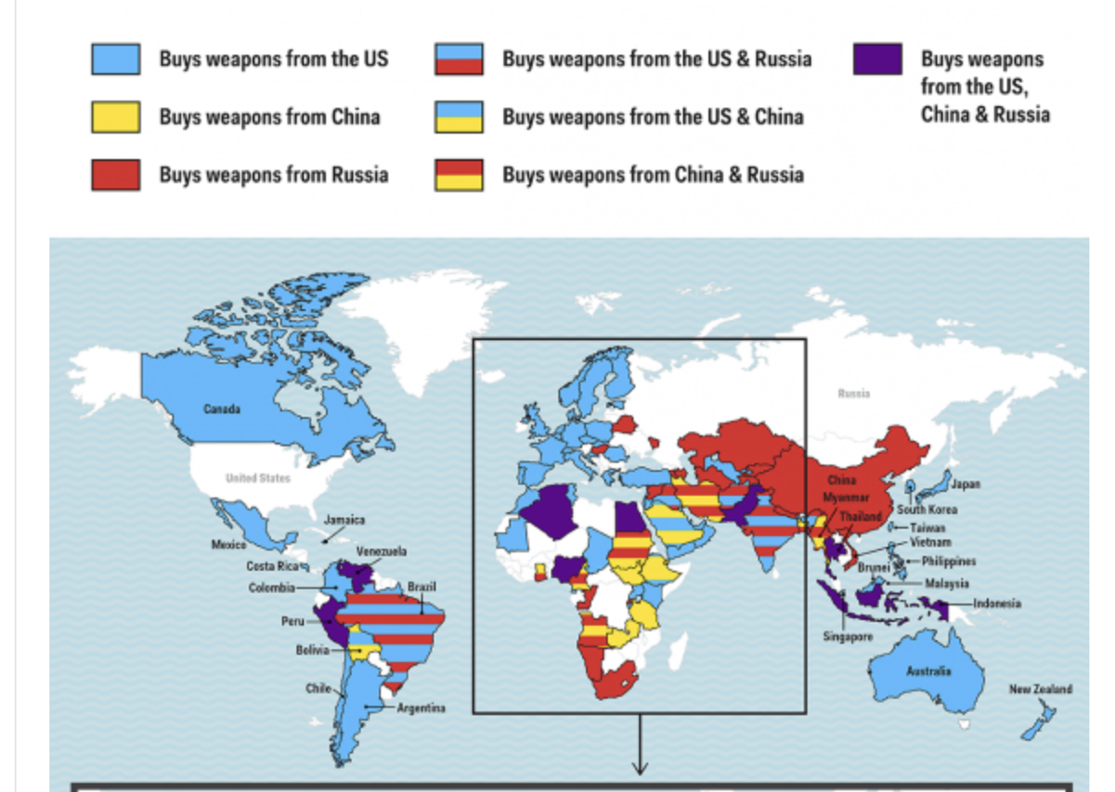

Slide 13
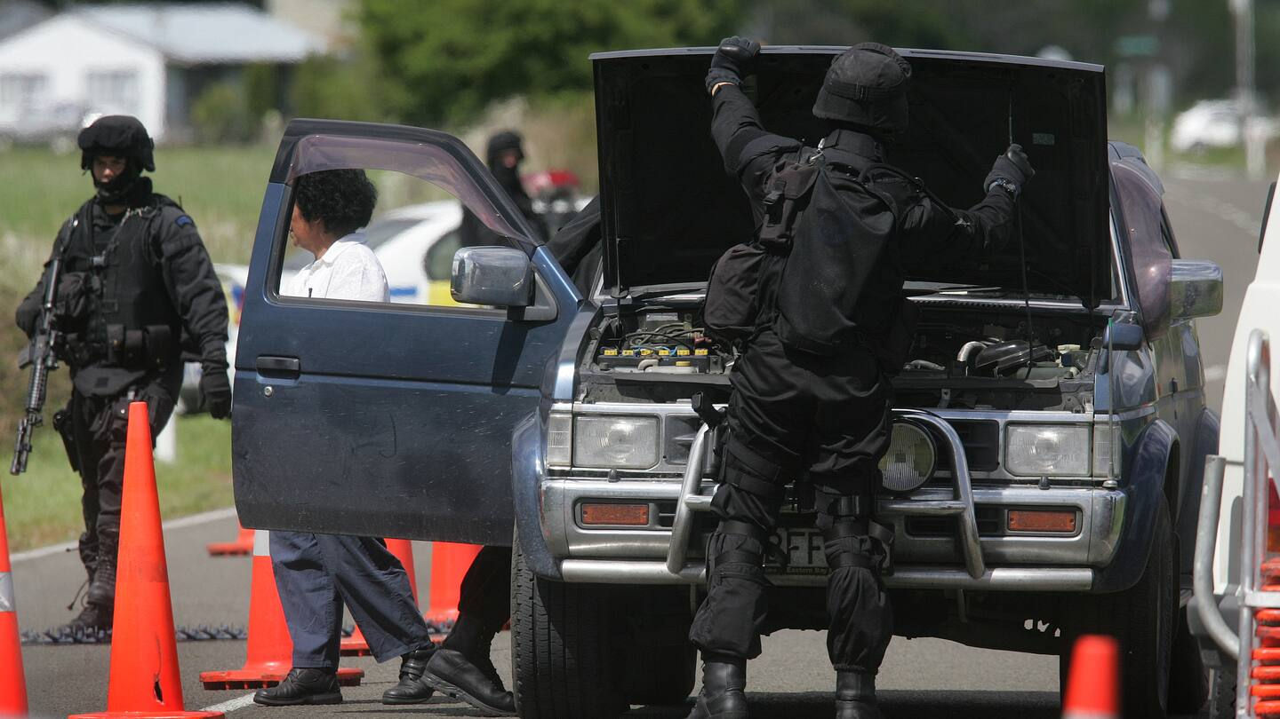
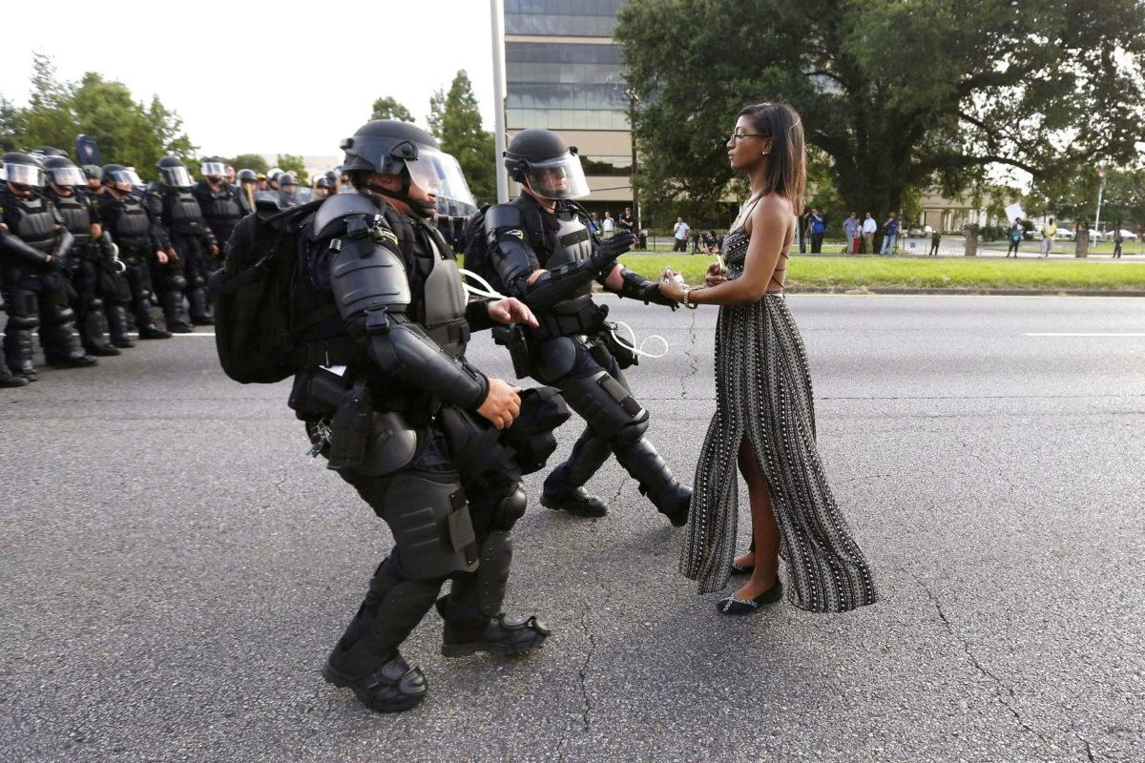
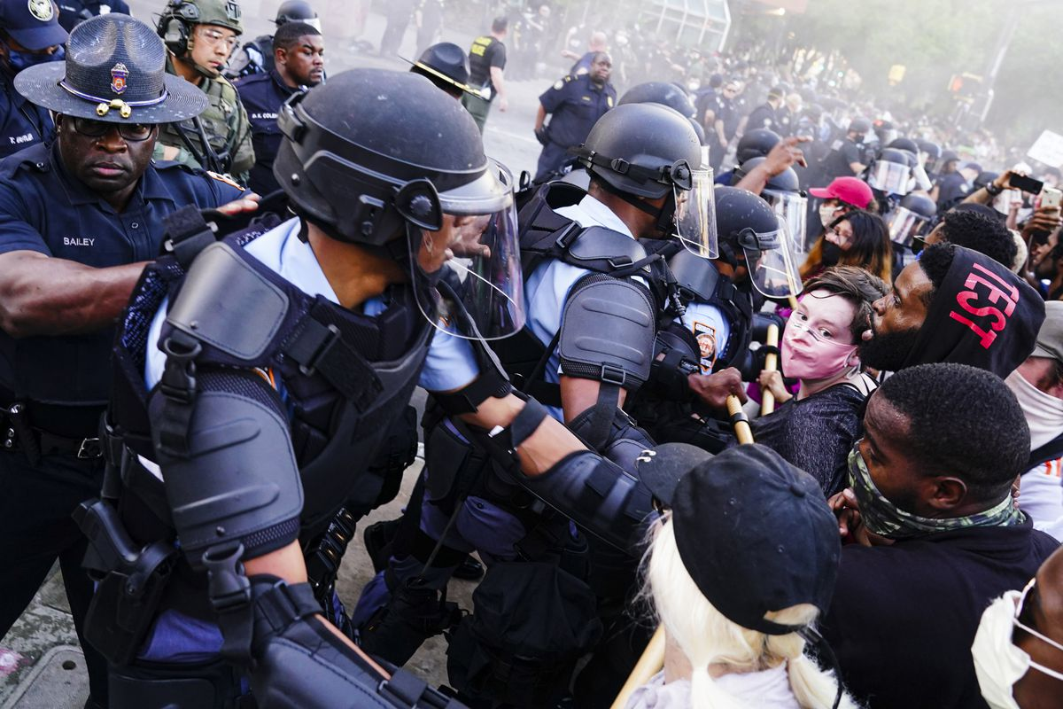
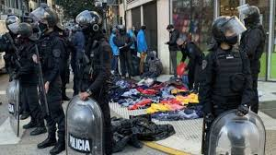
the wars within…

Slide 14
Putting colonialism and imperialism at the center of ‘war’
In this sense, the endless war of coloniality is both, more discriminating and also more
lethal than a generalized war in which all human beings act like wolves. Modern gendered and ethno-class Man creates and preserves borders of differentiation that aim to distinguish bodies, spaces, knowledges, and forms of being targeted for elimination, rape, and torture, from others that are meant to be protected from such actions. In its most basic form, metaphysical catastrophe refers to transmutation of the human, from an intersubjectively constituted node of love and understanding, to an agent of perpetual or endless war. In modernity/coloniality, embodied subjects emerge, not by the interpellation of an- other, but by the co-constitution of regimes of knowledge, power, and being that aim to make of this subject an agent of coloniality. The subject is meant to support and help refine these regimes from generation to generation, making war endless (Maldonado-Torres, 2016, p. 20 emphasis added).

Slide 15
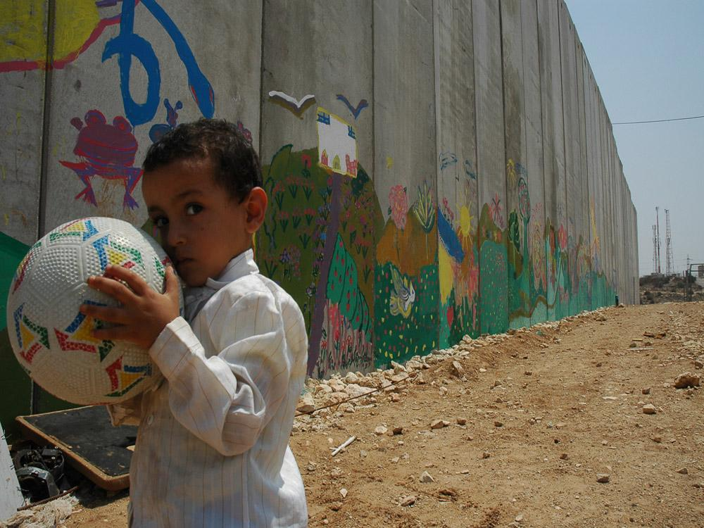
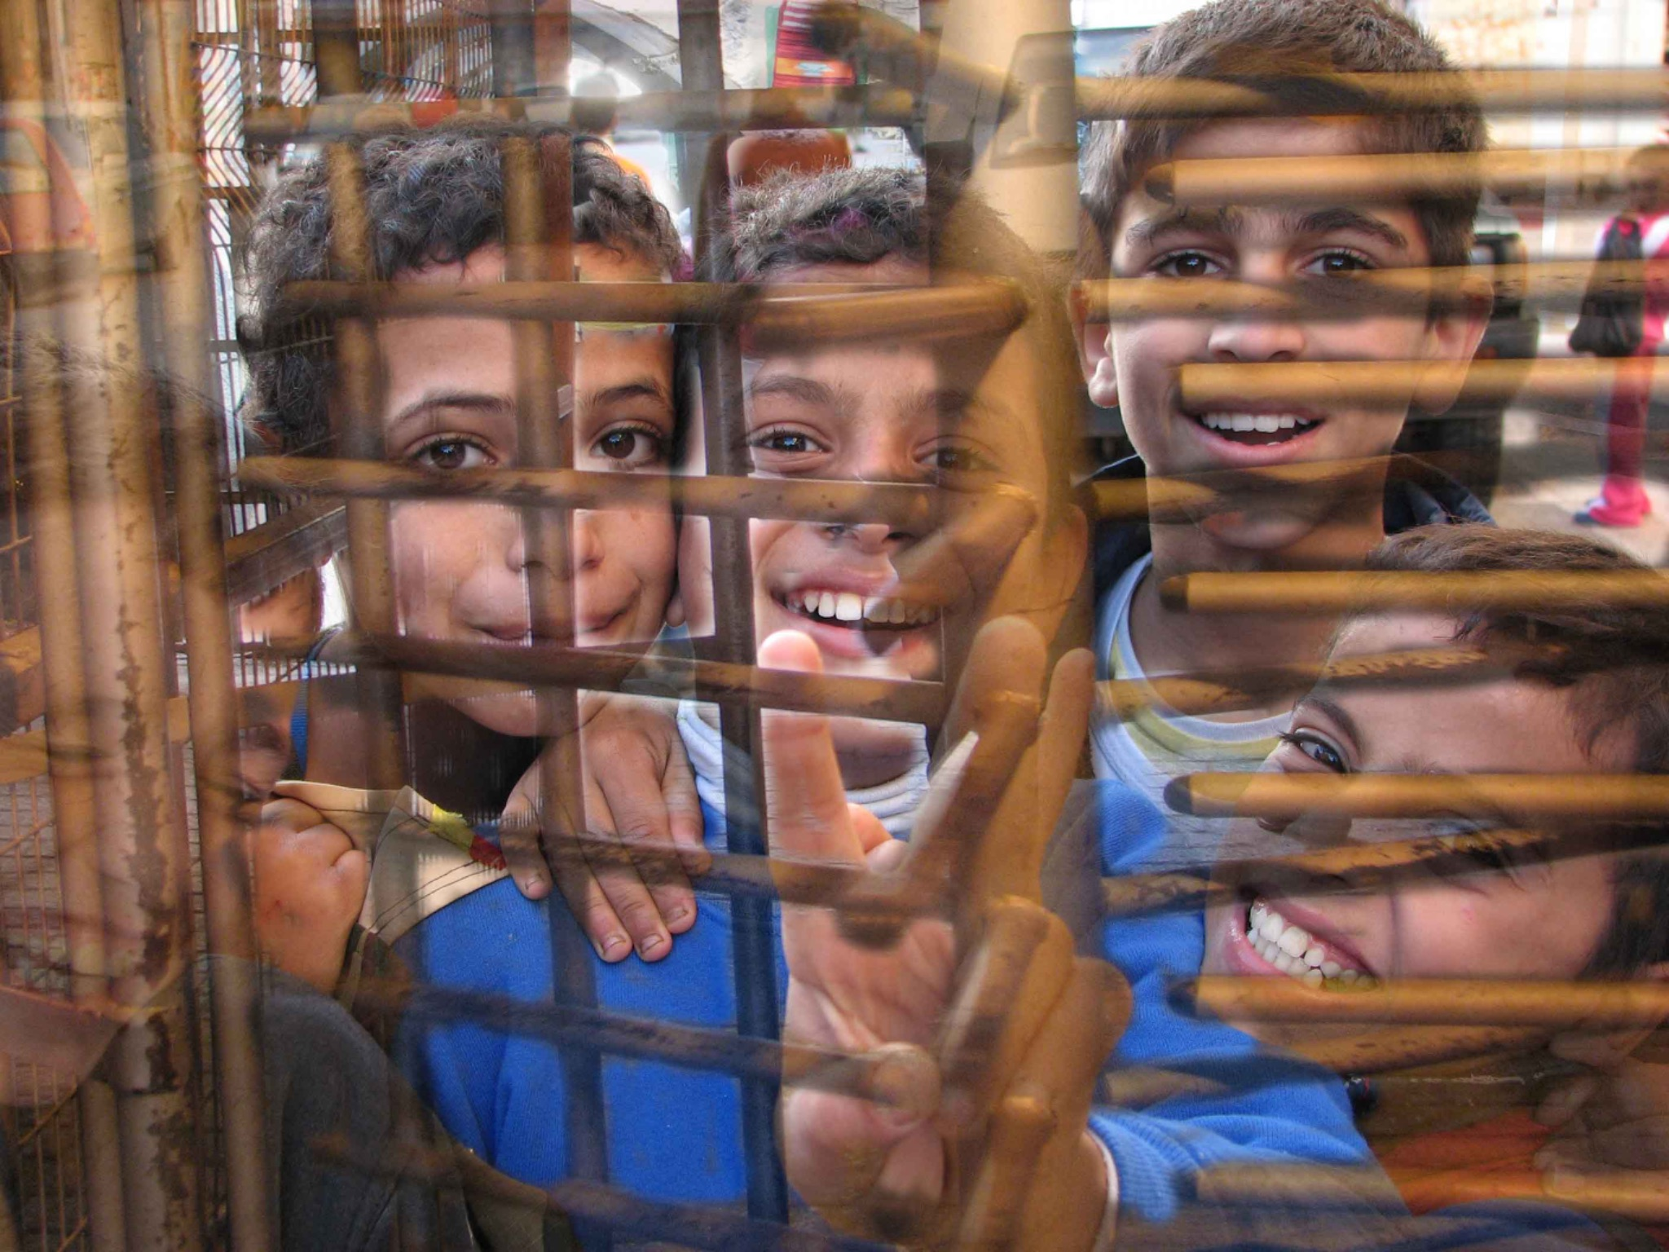
Who gets to be human? who gets to be innocent?
…the co-constitution of property and rights, rooted in the European Enlightenment, shaped a Eurocentric understanding of human rights. “The imperial attitude promotes a fundamentally genocidal attitude in respect to colonized and racialized people. Through it colonial and racial subjects are marked as dispensable.” (Maldonado-Torres 2007, p. 246; emphasis in original)
Despite universal human rights being championed as meta-political and equal, this perspective neglects the role of race, coloniality, and gender in defining 'the human'. The colonial continuity of race justifies the inferiority of certain groups, shaping global peace and conflict lines (Azarmandi, 2023). This includes, how is and isn’t considered human and when universality of human rights is invoked. Here, we can question who is and is not recognized as civilian victims in this particular moment.
Photo by Aisha Mershani

Slide 16
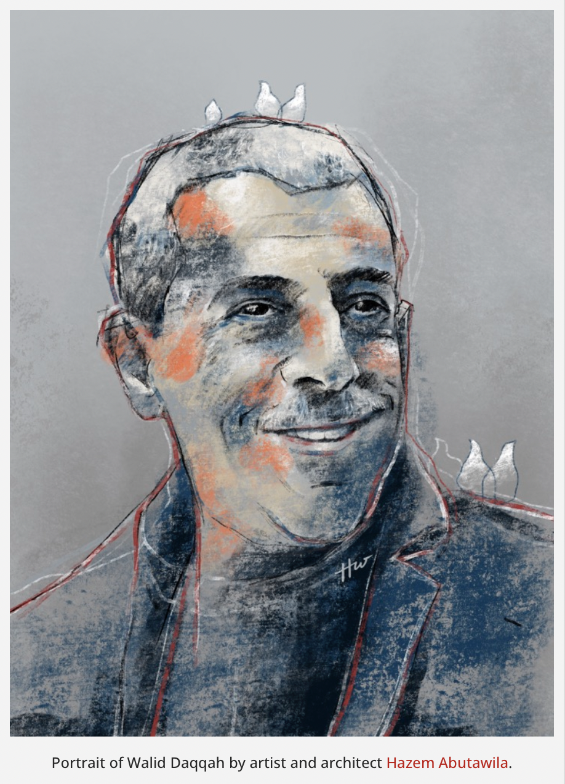
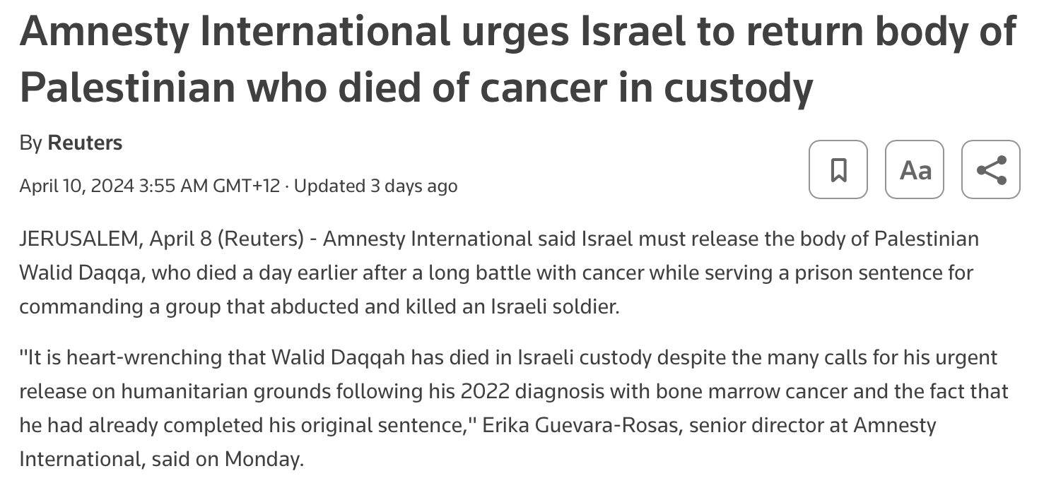

Slide 17
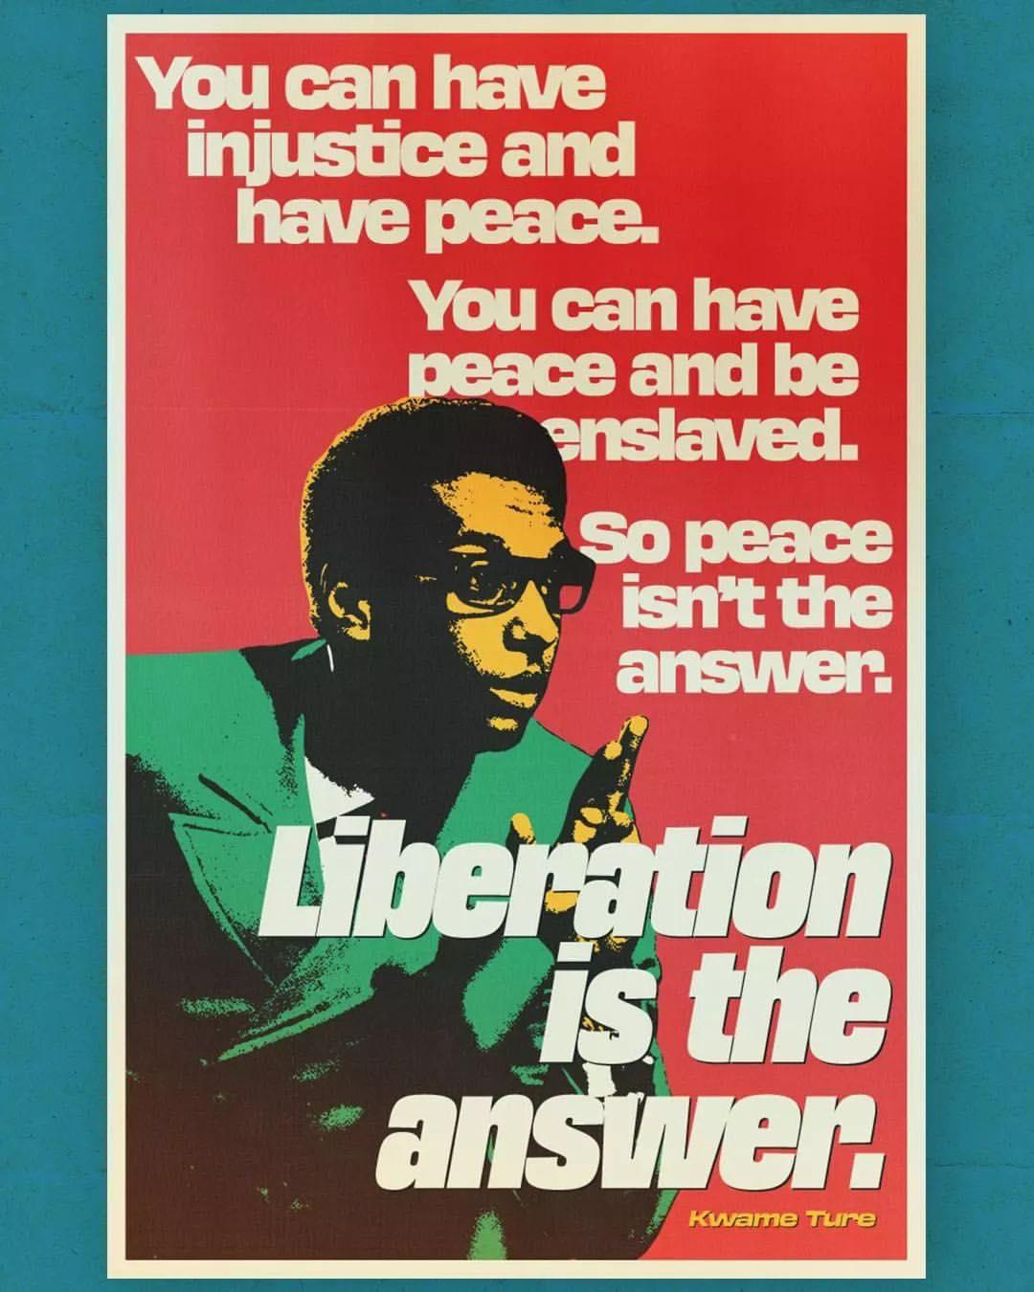
Rethinking peace through anti-colonialism

Slide 18
“In the Global South, the Bandung Conference in April 1955 emerged as a global reminder that the persisting existence of colonialism posed a threat to peace, irrespective of Cold War dynamics and the proliferation of nuclear weapons. Sponsored by the prime ministers of five Asian nations - Burma, Ceylon, India, Indonesia, and Pakistan - the conference transcended geopolitical divides that preoccupied Western peace advocates. While the latter were engrossed in the Cold War's ideological struggle, Bandung's delegates charted a broader course, steering the discourse towards economic development, human rights, and national self-determination, recognizing these as pivotal elements in the quest for world peace. ….
…Indonesia’s prime minister Ali Sastroamidjojo talked about peace beyond its conventional definition at the time. "Peace," he argued, "needs to eliminate fear and repression," a pointed allusion to the shackles of colonialism. He also pointed out that peace required a number of preconditions, such as the willingness and determination of living neighbourly together irrespective of each other’s political, social, or religious ideologies, on the principles of mutual respect for each other’s national sovereignty and each other’s territorial integrity; abhorrence of aggression; non- interference in each other’s internal affairs; equality and mutual benefit.” For nations in the Global South and colonised nations, peace then became both a precondition and consequence of decolonization and national self-determination.”

Slide 19
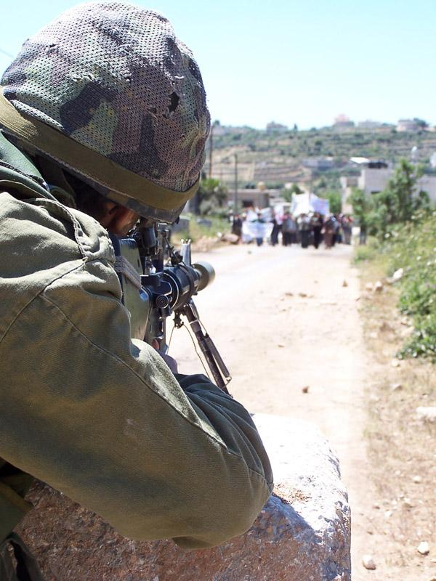
Radical activism for peace, challenging imperialism and capitalism, exacted a heavy toll. Figures like W.E.B Du Bois, Paul Robeson, and Claudia Jones faced criminalization, surveillance, and extensive harassment for their anti-imperial efforts. Peace efforts varied in consequences, with some endorsed while others were policed, echoing the struggle between cultivating the garden and the encroaching jungle. Similarly, individuals like Kwame Ture (formerly Stokely Carmichael) and Malcolm X found peace and violence intertwined, particularly within the context of US imperialism and white supremacy. Capitalism, racial justice, and decolonization were inseparable; as Burden-Stelly (2019) notes, "war, colonialism, and racialized oppression were mutually constitutive."
Photo by Aisha Mershani

Slide 20
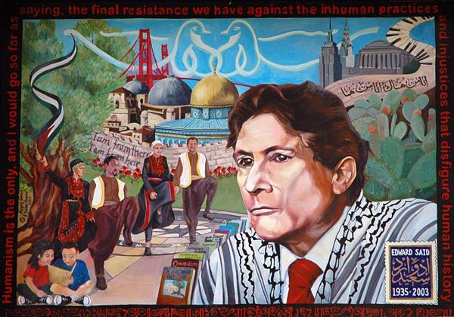

Fear of the
Or whose peace counts?
Notes:
The use of the watermelon as a Palestinian symbol is not new. It first emerged after the Six-Day War in 1967, when Israel seized control of the West Bank and Gaza, and annexed East Jerusalem. At the time, the Israeli government made public displays of the Palestinian flag a criminal offense in Gaza and the West Bank.

Slide 21
Today, we see the stifling of dissent & radical peace activism when it comes to mobilisation in support of a free Palestine in places like Germany, France and the U.S. similarly to the surveillance and repression faced by Black activists in the US (in past and present). Often, this repression is articulated by the state as a need to ‘keep the peace’ or maintain the ‘rule of law’
shortly after Hamas’ attacks on October 7th the Berlin school district sent out a letter to principles about how to ‘manage’ responses from students. The letter read that given Berlin's diverse student body, “fostering tolerance and embracing diverse viewpoints is integral to the educational mission”, however, such tolerance had its limits when it came to supporting violence and propaganda that supports “terrorist” violence. Consequently, the school district felt the need to inform parents and students of the guidelines “to maintain school peace”.
“Any demonstrative actions or expressions that can be interpreted as advocating or endorsing attacks on Israel or supporting the terrorist organizations conducting them, such as Hamas or Hezbollah, are prohibited in the current situation, as they pose a threat to the school's peace.
This not only includes carrying symbols, making gestures, and expressing opinions [...]. This can include:
● Wearing relevant clothing items (e.g., the Kufiya, known as the Palestinian scarf).
● Displaying stickers and decals with inscriptions like "free Palestine" or a map of Israel in the colors of Palestine (white, red, black, green).
● Shouting slogans like "free Palestine!" and demonstratively verbally supporting Hamas and their terrorism.” (emphases added)”

Slide 22
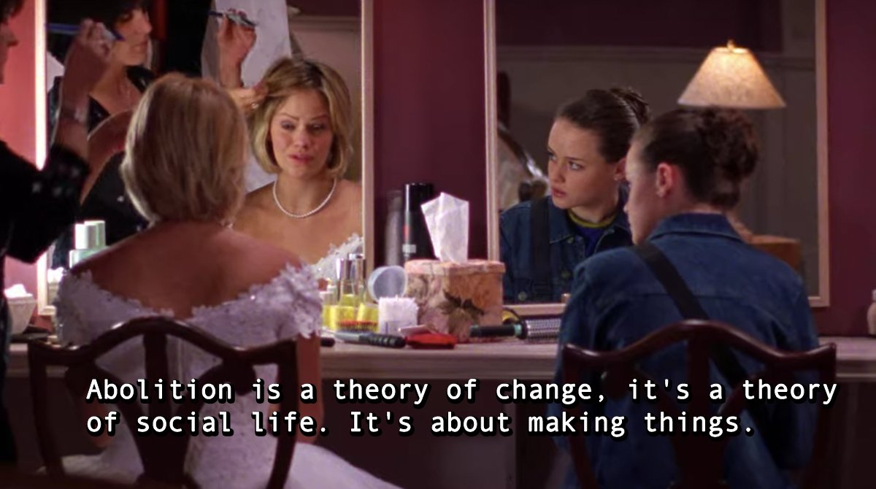
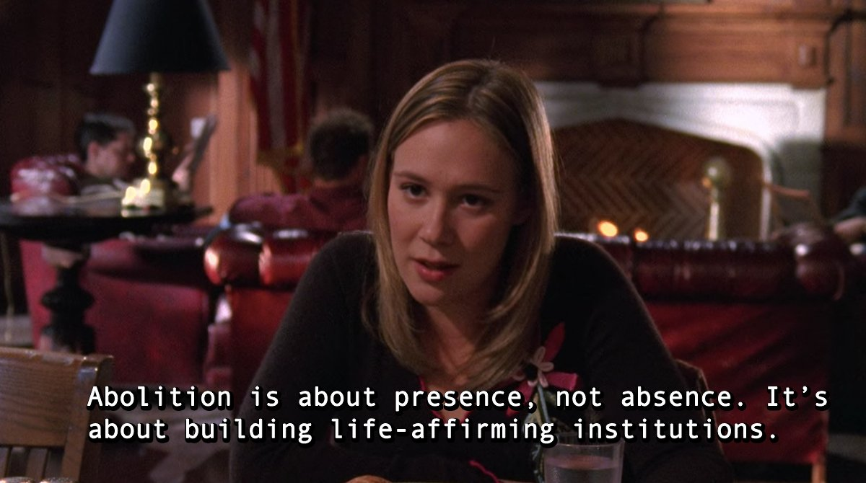
A world without war…

Slide 23
Questions?
Art work by fu fighter arts

